Slide 1
HOW TO CHOOSE A PRIVATE SKATING COACH

Slide 2
Please note:
Private Lessons are the coaches separate, private business. They are not run through, monitored or regulated by the MPSC Skating Program.
Private lessons, unless otherwise stated, are generally accepted to run into perpetuity. The idea is that you're choosing a coach to stay with for a while to take you through the levels, in addition to the classes you signed up for.
Coaches set their own rate and schedule, and make their own decisions about their business.

Slide 3
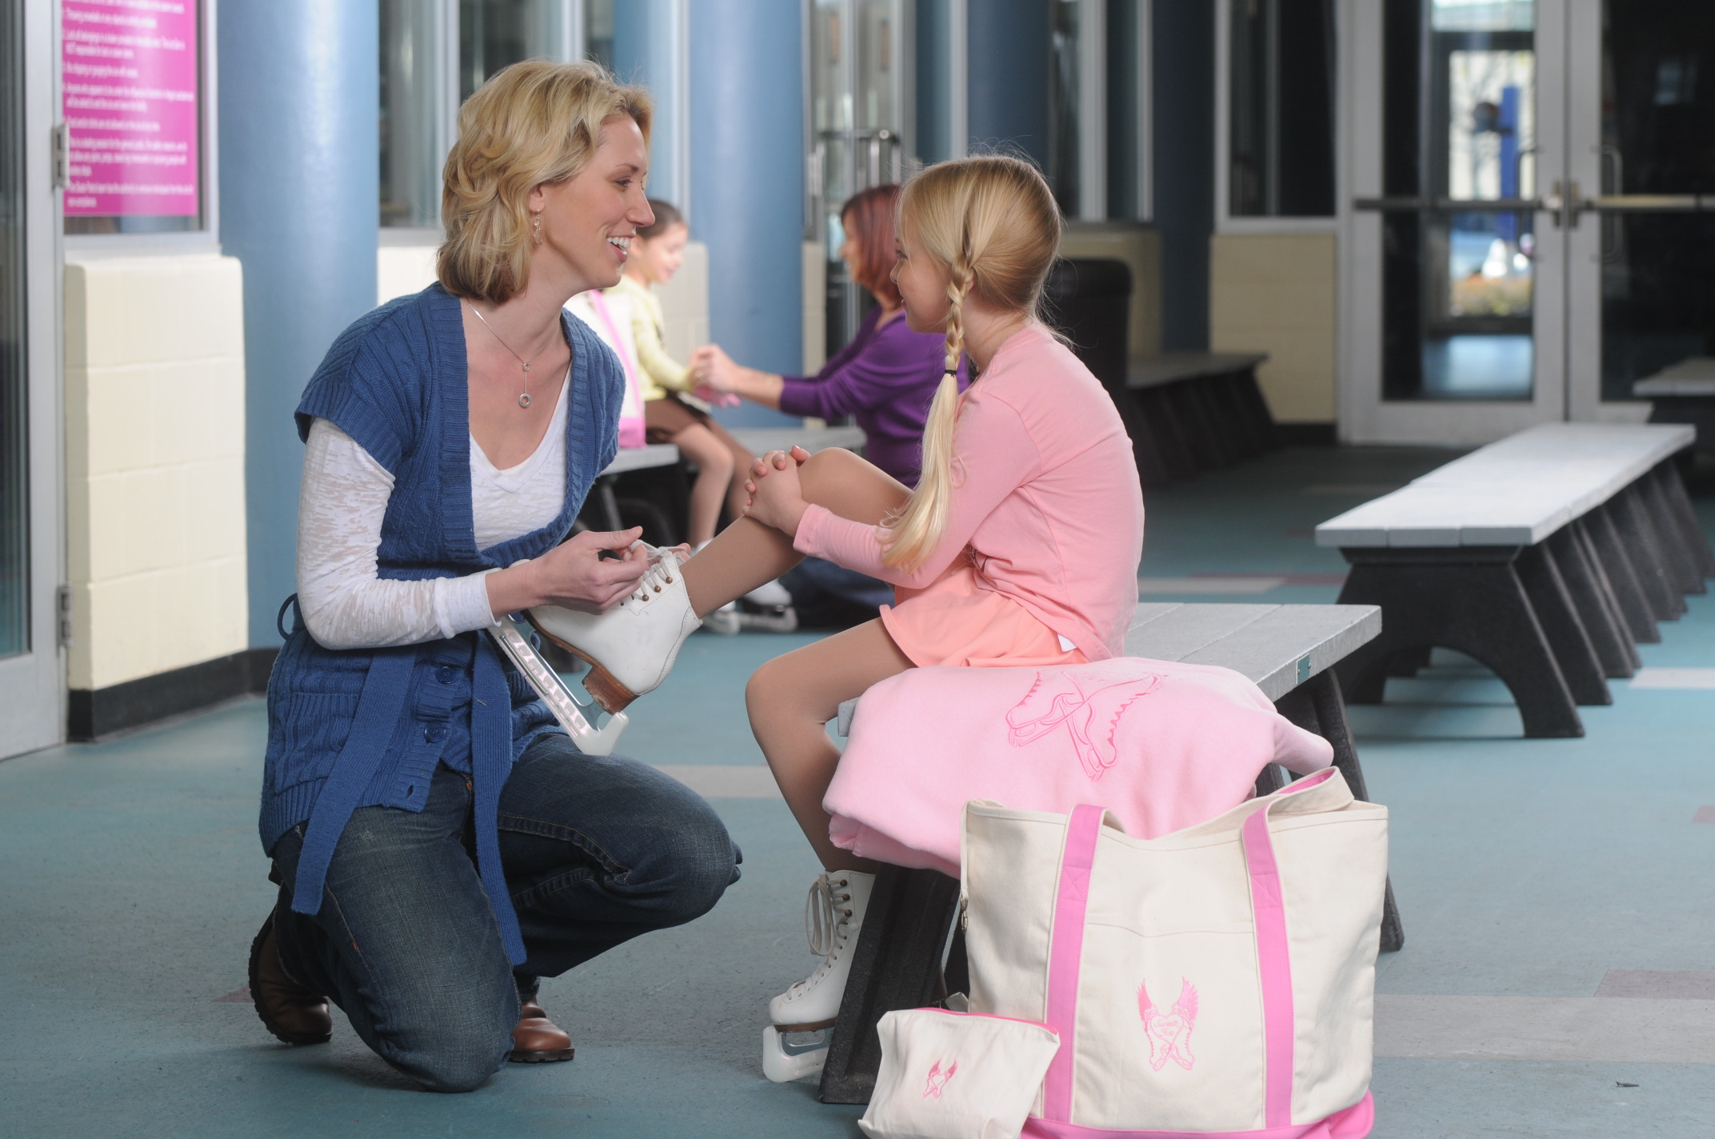
Before you begin your search…
Ask yourself and your skater these questions!

Slide 4
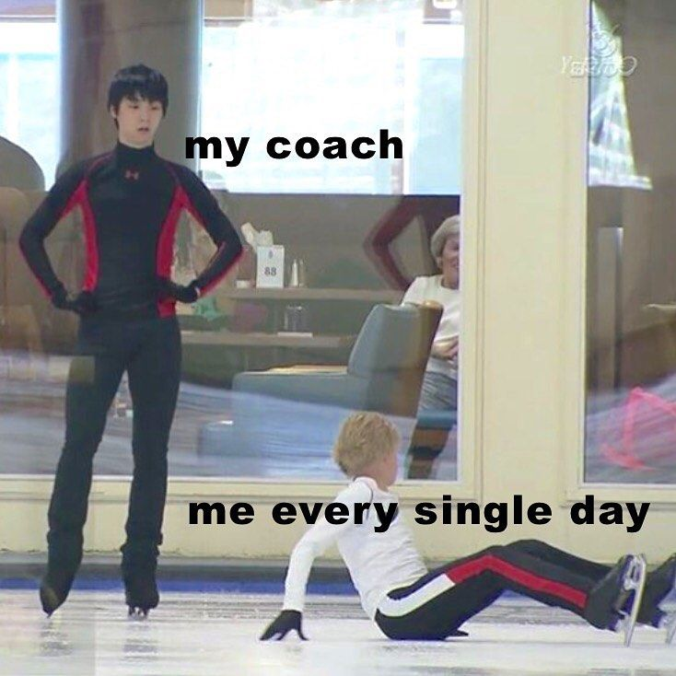
Before you begin your search:
Why are you interested in private lessons?
Would you like help on a specific element or skill? / Or are you looking for a long-term association?
Are you interested in trying another skating discipline?
  Synchronized Skating / Pairs / Ice Dance
Do you want to compete or participate in a show?
How much time do you want with a coach?
  Beginners: usually only once a week / half hour lesson.
More serious skating means more ice time and perhaps additional lessons.

Slide 5
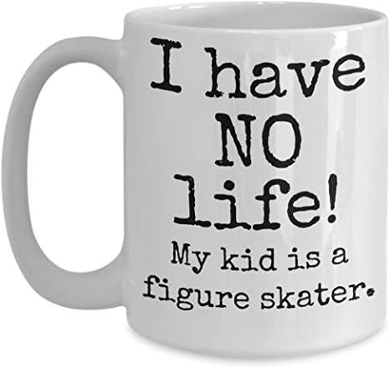
Before you begin your search:
What are you expecting from your coach?
When choosing a coach, take these factors into account:
Skater’s and Coach’s personality
Coach’s experience
How much are you looking to spend?
  Avg cost is $20 – $40 / 30 minutes.
  Rate is based on experience: personal level of skating, number of years and level of coaching, what tests they have passed as skaters, and what tests and qualifications they have achieved as coaches.
  Coaches who charge a lower rate, are generally new, less experienced, and great basic level coaches.
  Coaches who charge more, have been coaching longer, hold more qualifications, and have the ability to coach successfully at higher levels.

Slide 6
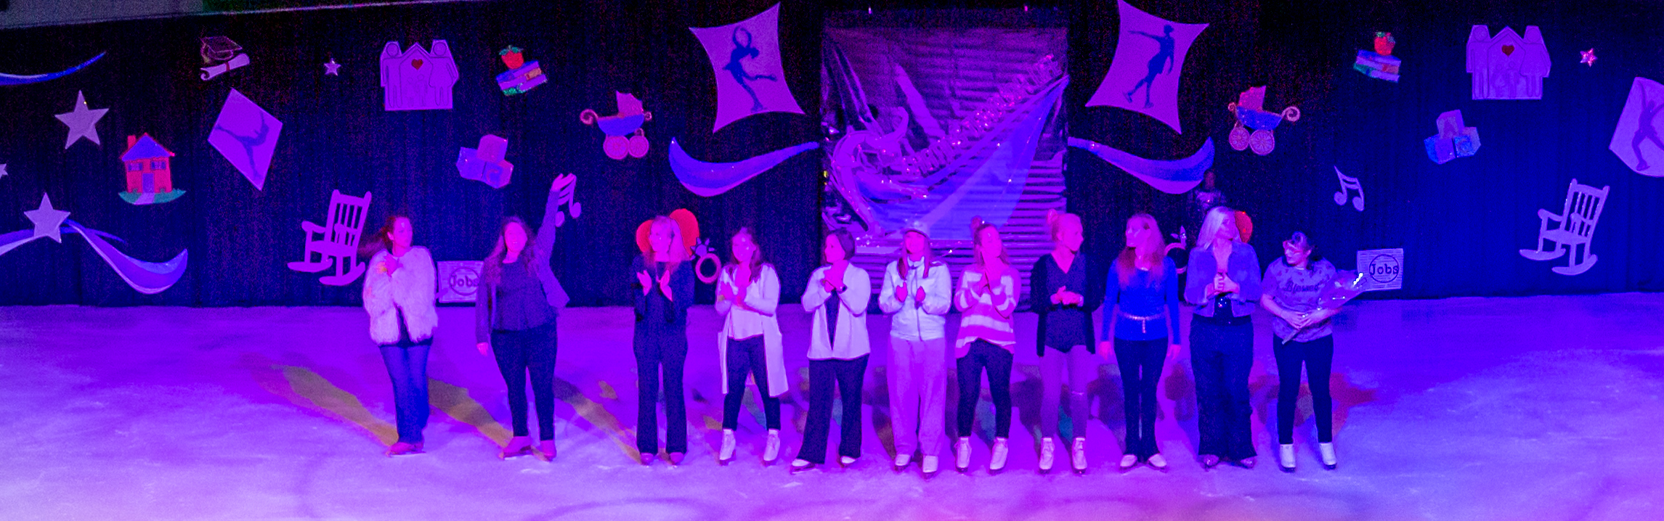
Finding a coach
Who do I choose?

Slide 7
Finding a coach:
Who do I choose?
There are 3 ways you can begin a conversation with a coach:
Best approach: If your skater knows / enjoys working with any specific coach, you are welcome to approach or contact them yourself, and ask if they have availability and what their rates are.
  Coaches are not allowed to solicit private lessons while ‘on the clock’ at MPSC. YOU / the guardian must make the ‘first move’.
    A coach may approach you and say that they believe your skater would benefit from a private coach. But they are not allowed to say that they can benefit from private lessons WITH THEMSELVES.
    A coach has limited time between classes to hash-out details about their rates / experience / schedule / etc, but they are allowed to give you contact information if you ask for that information FIRST.
  I’m not allowed to share a coaches specific contact info, but I can pass your information on to any specific coaches, so they can contact you, once they are off the clock.

Slide 8
Finding a coach:
Who do I choose?
There are 3 ways you can begin a conversation with a coach:
If you / your skater don’t know any of our coaches, but would like a suggestion:
  The Skating Coordinator knows coaches strengths & most skaters personalities!
  If you trust that connection, contact the MPSC Skating Coordinator, and she would be happy to give you a short list of coaches who might be a good fit with your skater.
If you / your skater don't know any of our coaches, or don’t really have a preference:
  Fill out the “Private Lesson Request Form” on the MorganParkSportsCenter.com website
  If a coach has the time that you’re asking for available, then they will contact you directly.

Slide 9
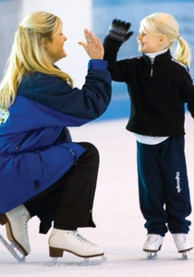
Finding a coach
Is this coach right for my skater?

Slide 10
Finding a coach:
Is this coach right for my skater?
Parent Priorities
Confirm basic requirements:
  Learn to Skate USA Instructor Membership /or/ US Figure Skating Membership
  LTS USA / USFS Safesport* and Background Check compliant
  Liability Insurance that is on file with rink Skating Coordinator
Ask about other qualifications
  How many years have you been teaching LTS classes and/or teaching privates?
  Professional Skaters Association (PSA) membership?
  Completion of CER courses
Do you demonstrate a standard of ethics and will you be a good role model for my child?
Will you treat me and/or my child politely, with respect and enthusiasm?
  It’s important to set boundaries and priorities with this person who will be spending a lot of unsupervised time with your child.

Slide 11
Finding a coach:
Is this coach right for my skater?
Coaches Guidelines
What are your private lesson rates?
Do you offer “Trial Lessons” to see if it’s a good fit, before committing?
Do you work with a team of coaches, or will I only work with you?
  Many coaches specialize in specific areas, and so work along with other coaches to bring those specialized skills into play.
What important policies do you keep?
  Cancellations (Coach vs Parent cancelled / Time frame)
  Payment Plans / Options
  Team Coaching rates/plans
Do you have a specific plan to teach the appropriate skating and technical skills?
What are your preferred communication methods?

Slide 12
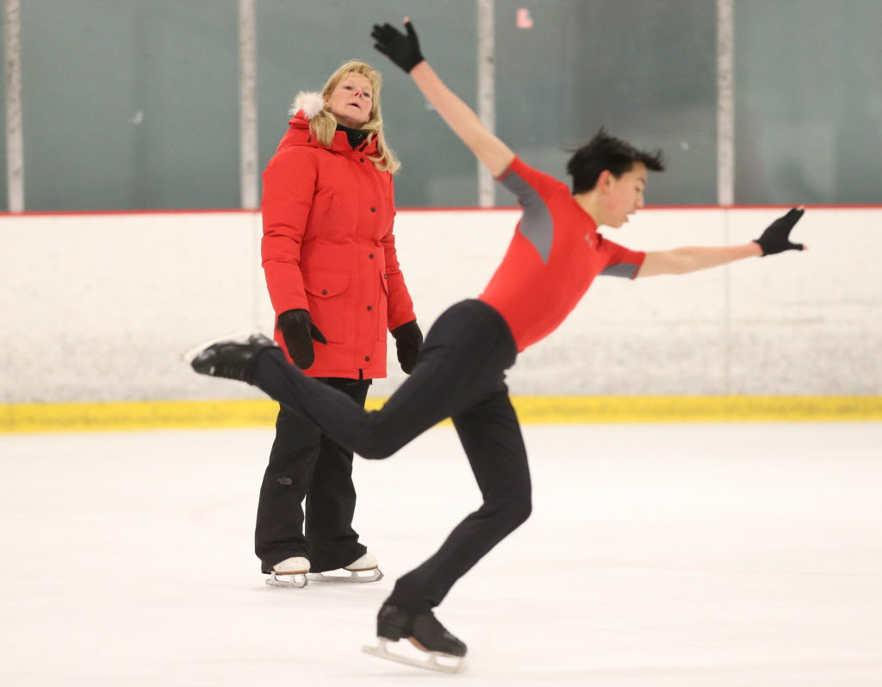
Best Practices
WHAT ARE SOME RED and GREEN FLAGS OF POTENTIAL COACHES?

Slide 13
Best Practices
A good coach:
Knows the sport and keeps up with current rules. Helps parents and skaters understand the complexities of figure skating.
Knows about differences in personality. What is right for one child isn’t necessarily right for another. Your coach should be well-versed in athletes’ different learning styles.
Understands each athlete’s motivation for skating. Some are more serious about competing; others enjoy it as a recreational activity
Understands and can deal with differences in physical and emotional maturity. Appreciates each skater for his or her individuality and gives age-appropriate instruction based on each skater’s development
Has more than just winning in sight. Helps students set long- and short-term goals to achieve success in other areas than winning. Promotes confidence, self-esteem and character development above all else

Slide 14
Best Practices
A good coach:
Is skilled at teaching the fundamentals of skating. Improvement is the primary source of enjoyment for athletes
Advises appropriate equipment purchases. Your coach should not encourage you to purchase equipment or accessories to ‘look the part’.
  Skating is ‘known’ for being a sport only for affluent families – but this is NOT the case. Especially at the level at which we’re skating!
Makes skating fun. Displays a positive, motivational and encouraging demeanor.
Teaches skaters to enjoy success and respond to failure with new determination.
Teaches a love of skating.

Slide 15

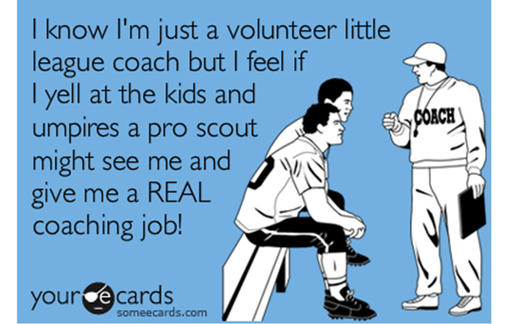
Best Practices
RED FLAGS:
Isolating or Removing skater from facility programs, such as Learn to Skate programs or teams.
Communicating (texting/ messaging/ conversing) with skater, without guardians present.
Inappropriate or oversharing of personal activities or beliefs with skater or guardians.
“Friending” students on social media.
Criticizing or belittling fellow coaches, or facility management.

Slide 16
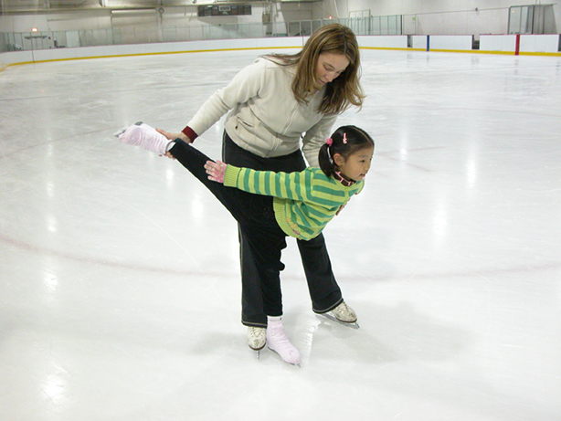
Recap!
Key things to remember

Slide 17
Recap
Before you find a coach: Have a good idea of what you’re looking to get out of private lessons
3 ways of Finding a coach:
  Approach a coach
  Ask Skating Coordinator for Suggestion / to give out contact info
  Ask to fill out Private Lesson Request Form
Make sure it’s the right fit: Ask lots of questions to get a good indication of the coaches experience, and styles of coaching, communication and management.
Have a plan to start: Trial Lessons / OR / how long lessons will last / OR / into perpetuity.
Maintain good communication with your skater and the coach, so you are aware of all interactions, and can keep an eye out for Red and Green flags!

Slide 18
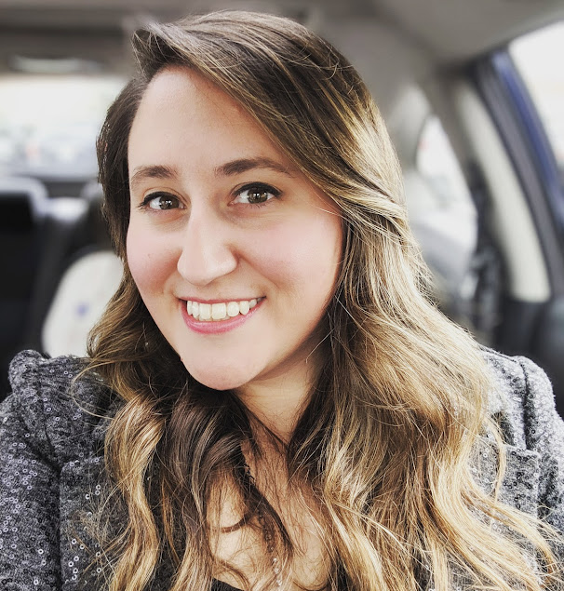
Contact Info
Kathy Janik
Kjanik@MorganParkSportsCenter.net
773 – 945 – 6014

